Slide 1
SDLC Life Cycle Models

Slide 2
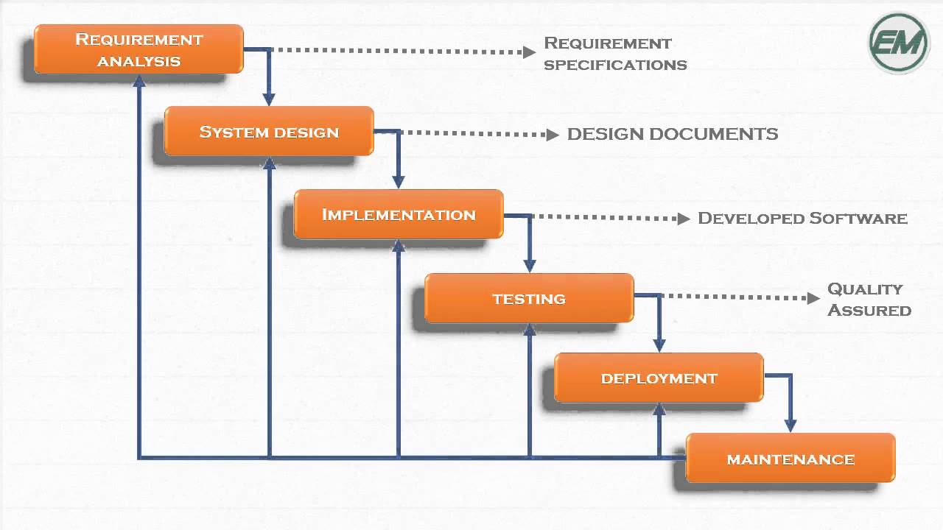
Waterfall Model

Slide 3
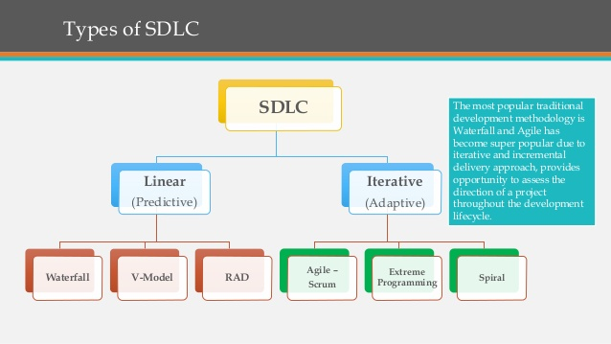
Ref : https://www.techuz.com/blog/top-12-sdlc-methodologies-with-pros-and-cons/ https://melsatar.blog/2012/03/15/software-development-life-cycle-models-and-methodologies/

Slide 4
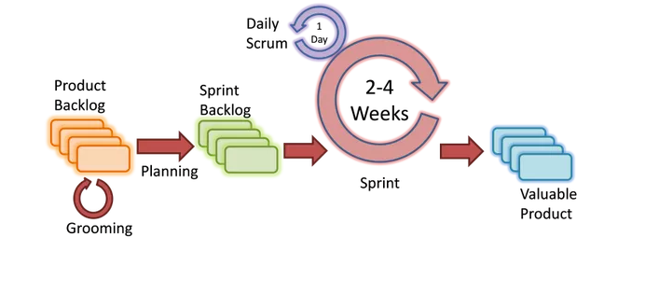
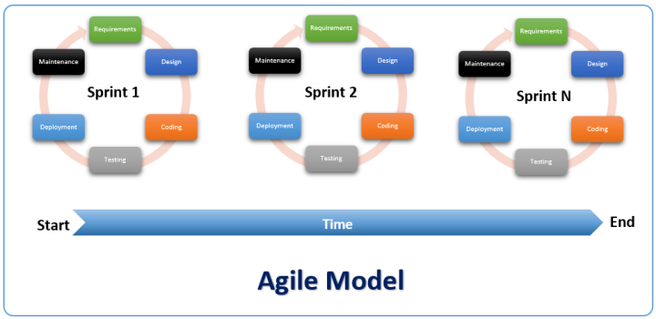

Slide 5
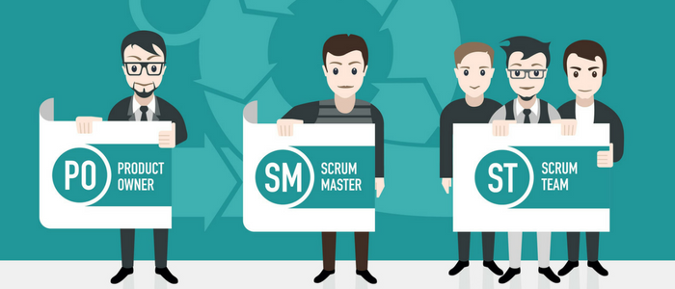

Slide 6
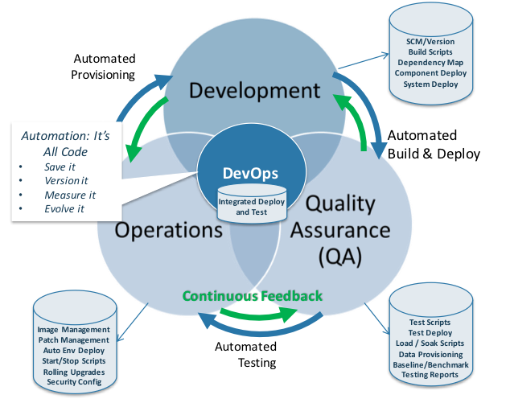

Slide 7
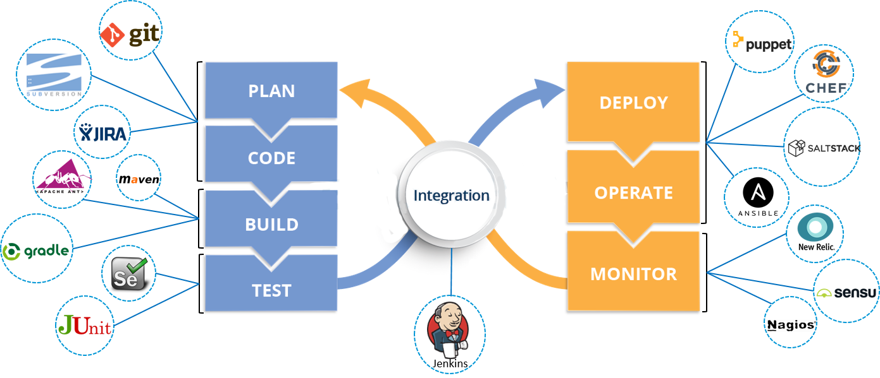

Slide 8
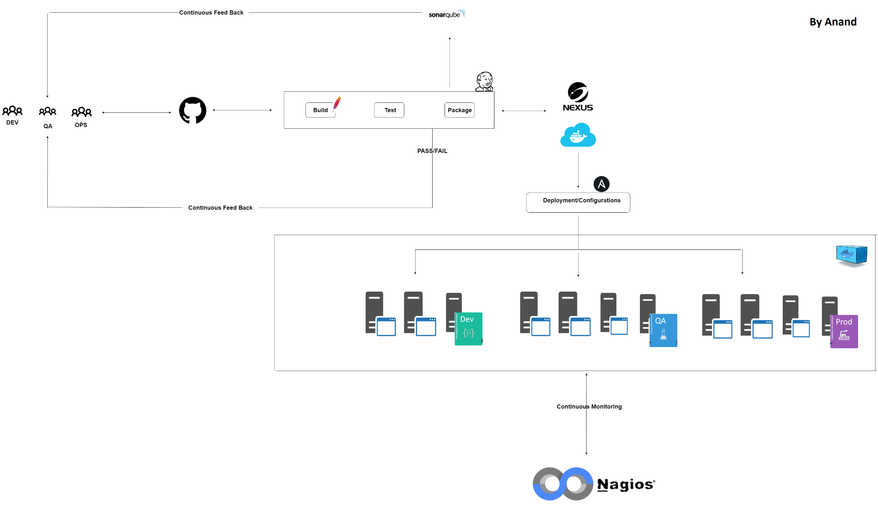
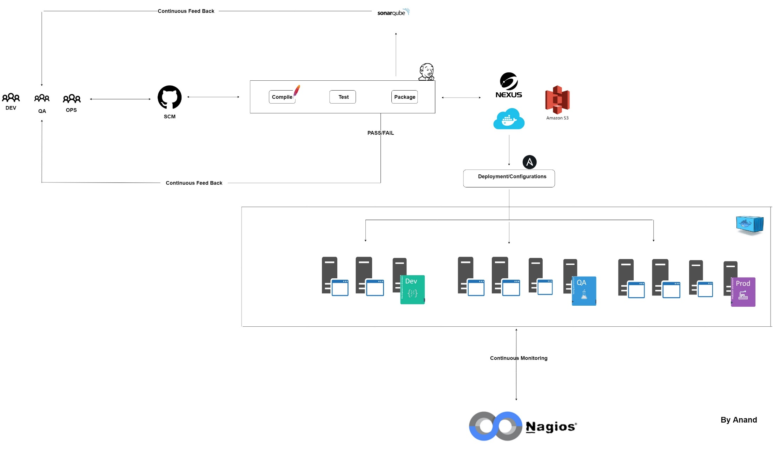


Slide 9


Slide 10
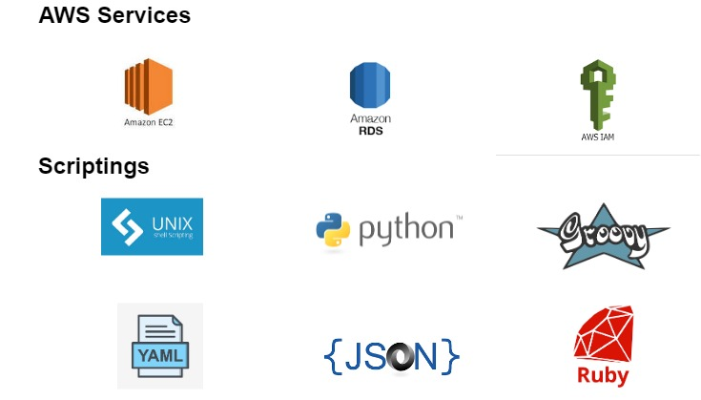

Slide 11
Thank you

